Slide 1

Educating Iowans with a focus on youth regarding the breadth and global significance of agriculture.
Managing the Threat and Protecting the Harvest
– Soybean Aphids

Slide 2

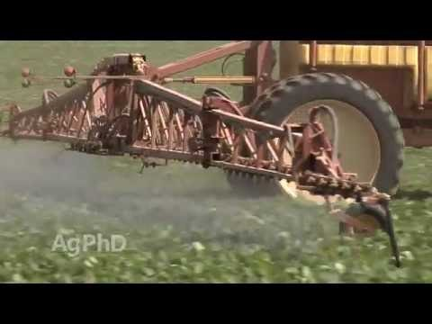
Agroecosystems – Pests
HS-LS2-2. Use mathematical representations to support and revise explanations based on evidence about factors affecting biodiversity and populations in ecosystems of different scales.
Aphid count on soybeans to determine if/when to spray. Maintaining a balance in the ecosystem by increasing the number of ladybugs to control the aphids.
Problem since 2000-2004 when aphids were introduced

Slide 3
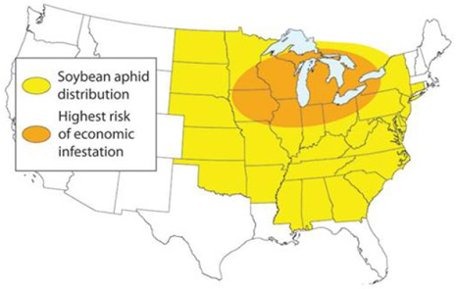
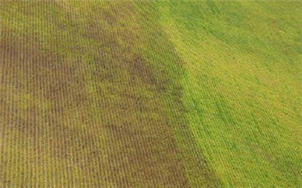
Agroecosystems – Pests
Aerial picture of unsprayed (left) vs. sprayed (right) field areas demonstrates the dramatic effect of soybean aphids and the benefit of treating.

Slide 4
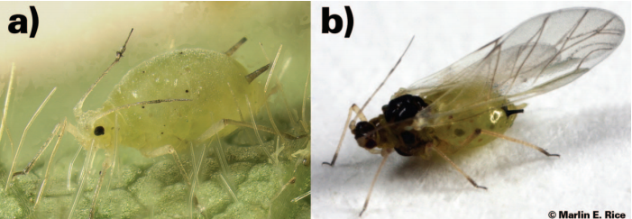
Agroecosystems – Pests
Soybean aphid:
a) typical colony-building wingless (apterous) form. Photo credit to Claudio Gratton; and
b) migratory winged (alatae) form. Photo credit to Marlin E. Rice.

Slide 5
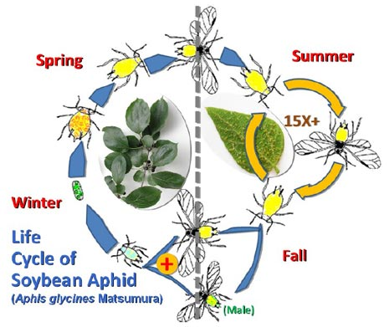
Agroecosystems – Pests

Slide 6
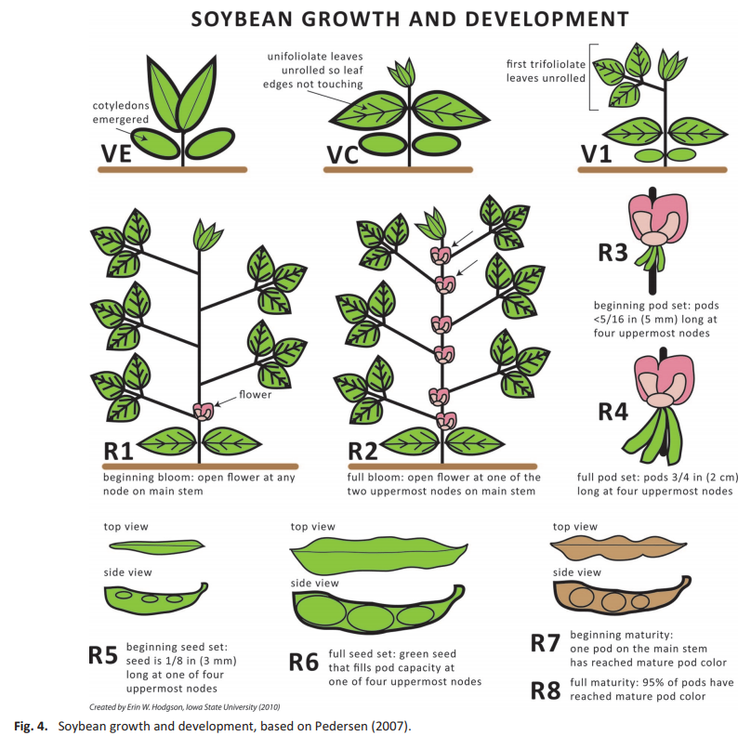
Agroecosystems – Pests

Slide 7
Agroecosystems – Pests
Speed Scouting Directions
Select the first plant at random. If less than 40 aphids are on the entire plant, mark a minus [-] for that non-infested plant. If at least 40 aphids are on the plant (STOP COUNTING when you reach 40 – this is the speedy part), mark a plus [+] for that infested plant.
Choose a direction at random and walk 30 rows or paces to the next plant.
Repeat Step #1 until 11 plants are sampled in different areas of the field.
Make a decision using the total number of infested plants (the total number of pluses).
If you must ‘continue sampling’ (7 to 10 plants with a +), sample five more plants and use the new total number of plants (16) to make a decision.
If no decision is reached, sample additional sets of five plants until 31 plants are sampled. Remember, always use the total number of plants to make a decision.
If no decision can be made after sampling 31 plants, resample the same field in 3 to 4 days.
A ‘TREAT’ decision must be confirmed a second time 3 to 4 days later. If confirmed, apply an insecticide in 3 to 4 days.

Slide 8
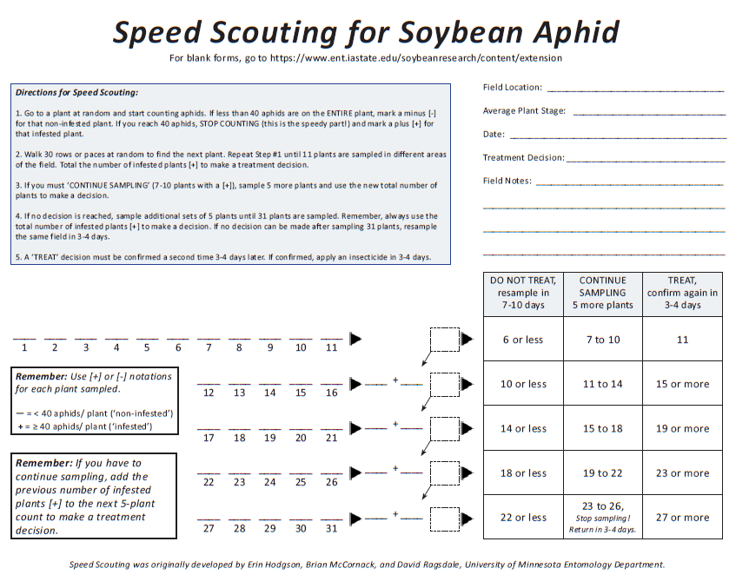
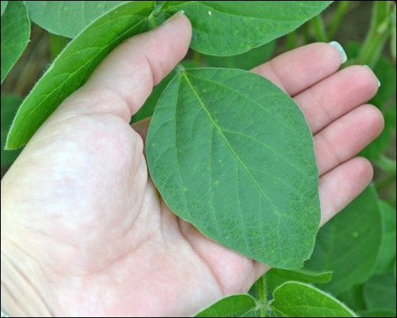

Agroecosystems – Pests

Slide 9
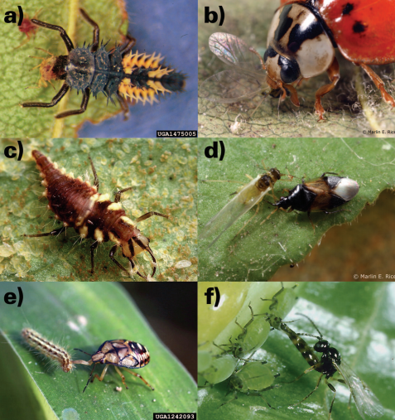
Agroecosystems – Pests
Common soybean aphid natural enemies
a) multicolor Asian lady beetle, Harmonia axyridis, larva. Photo credit to Whitney Cranshaw;
b) multicolored Asian lady beetle adult. Photo credit to Marlin E. Rice;
c) green lacewing, Chrysoperla spp., larva. Photo credit to Jack Dykinga;
d) insidious flower bug, Orius insidiosus, nymph. Photo credit to Marlin E. Rice;
e) spined soldier bug, Podisus maculiventris, nymph. Photo credit to Russ Ottens;
f) parasitoid wasp, Lysiphlebus testaceipes. Photo credit to Peter J. Bryant.

